Slide 1


YouTube Data Analysis – Country-Wise Content Trends

Slide 2

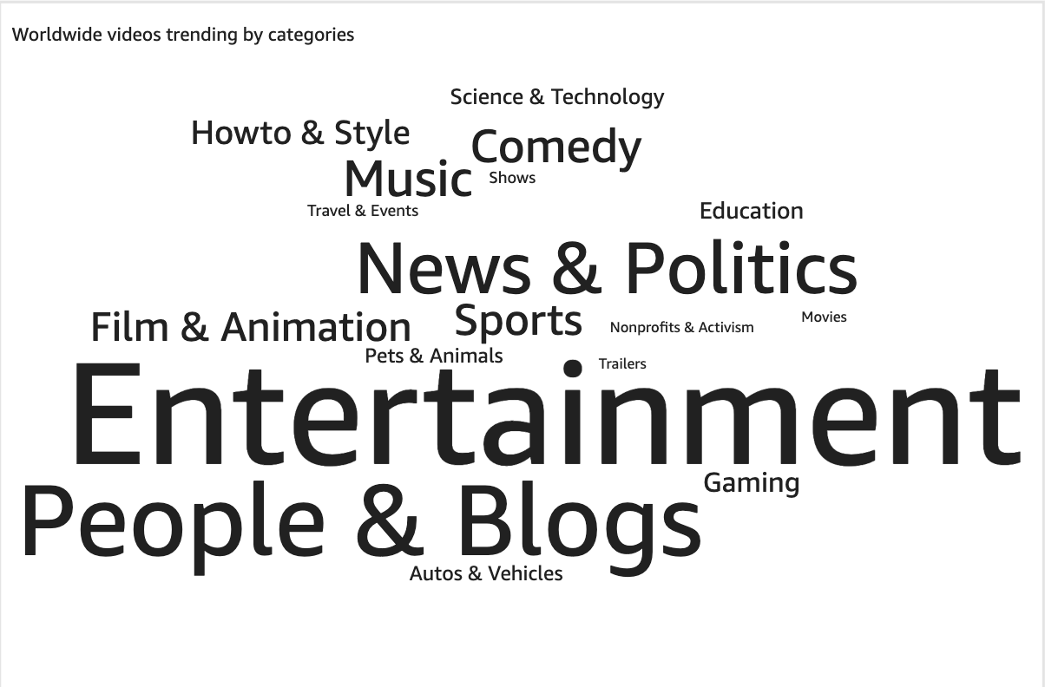
1. Worldwide videos trending by categories:

Slide 3
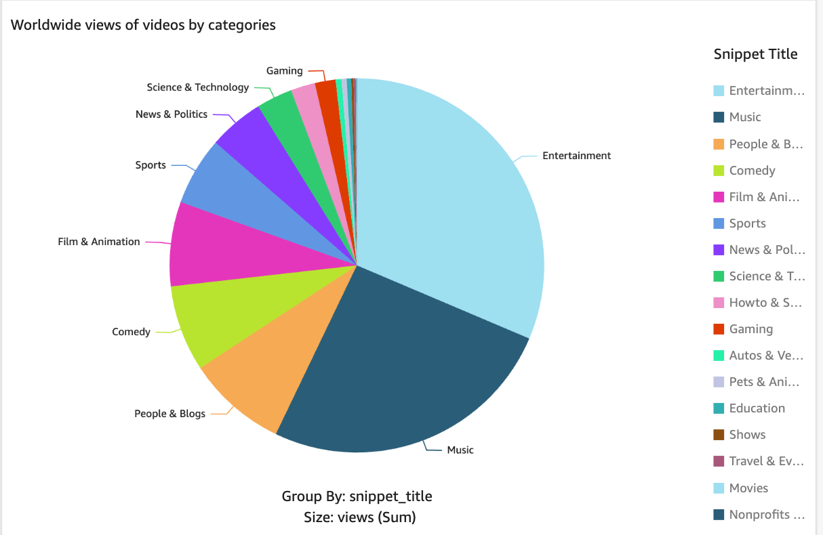
2. Worldwide total views of videos by categories:

Slide 4
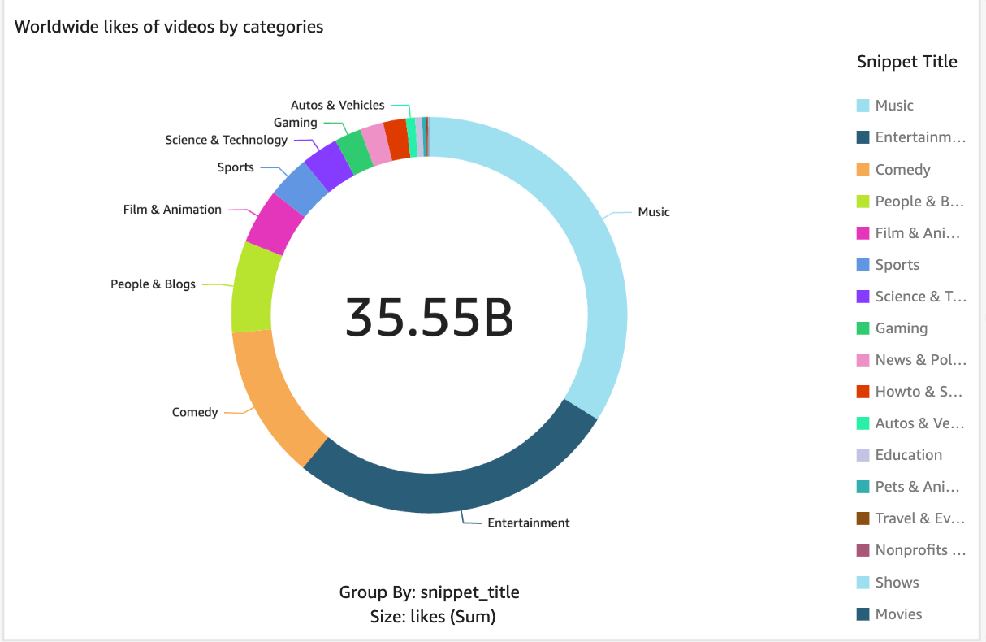
3. Worldwide total likes of videos by categories:

Slide 5
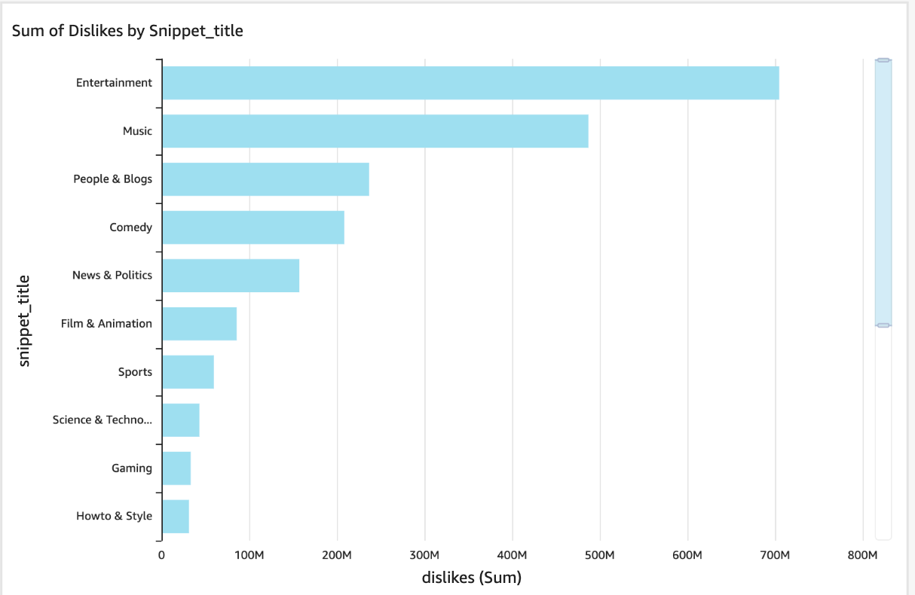
4. Worldwide total dislikes of videos by categories:

Slide 6
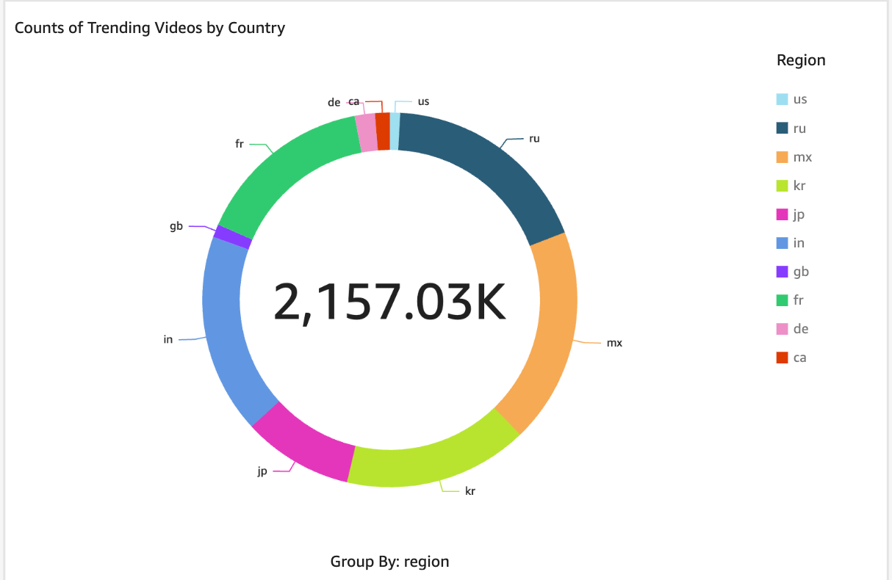
5. Count of trending videos by country:

Slide 7
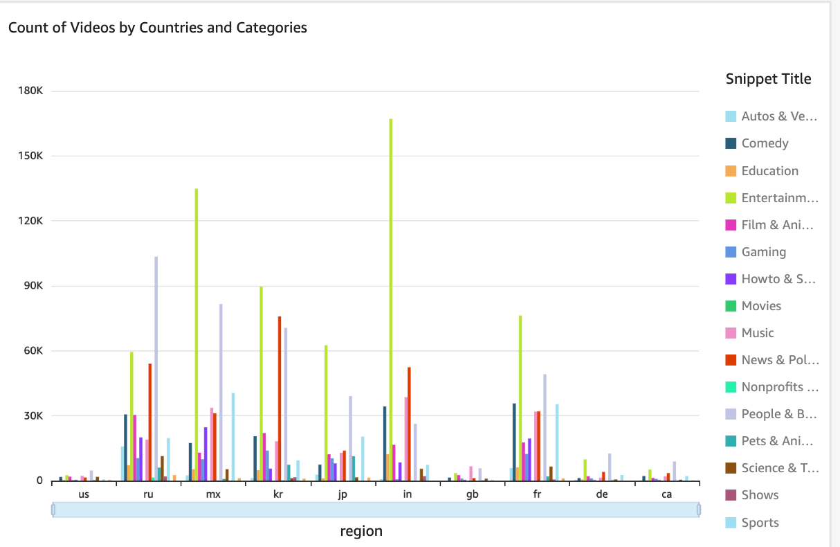
6. Count of videos by countries and categories:

Slide 8
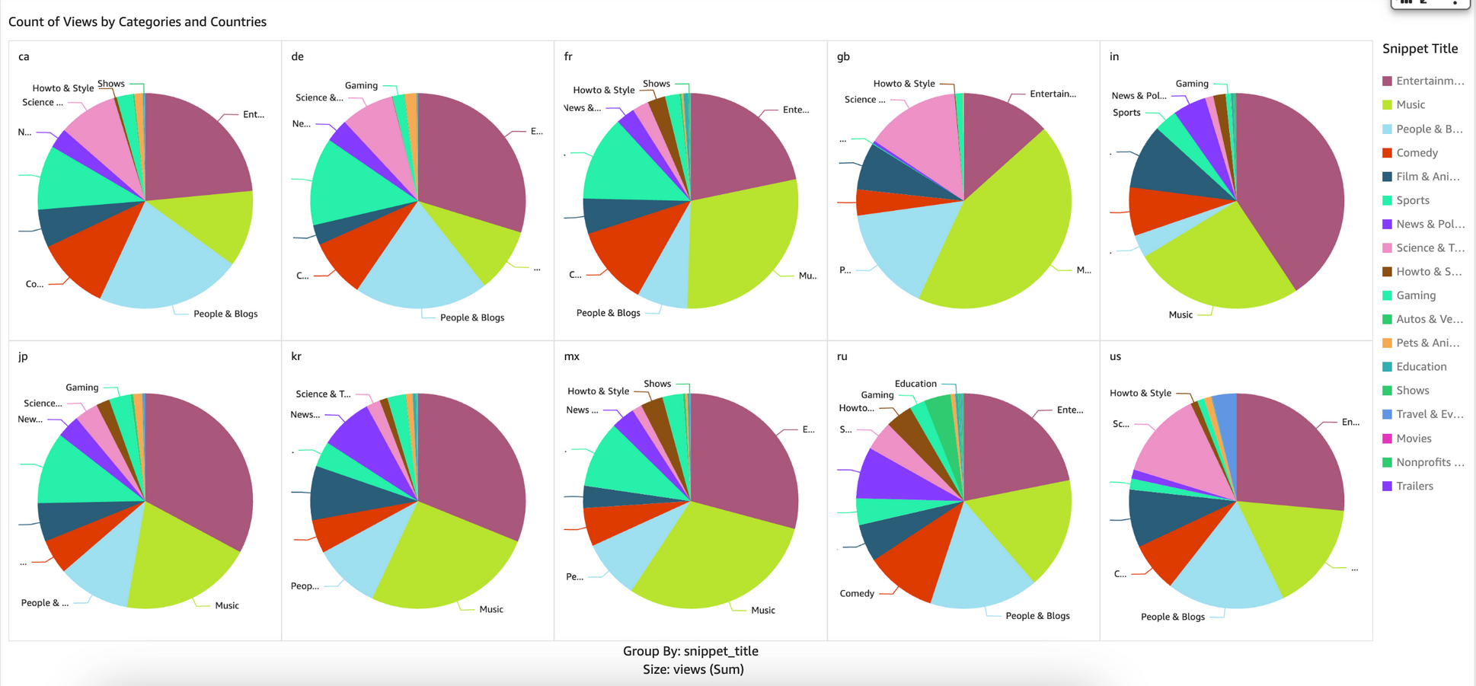
7. Count of total views by categories and countries:

Slide 9
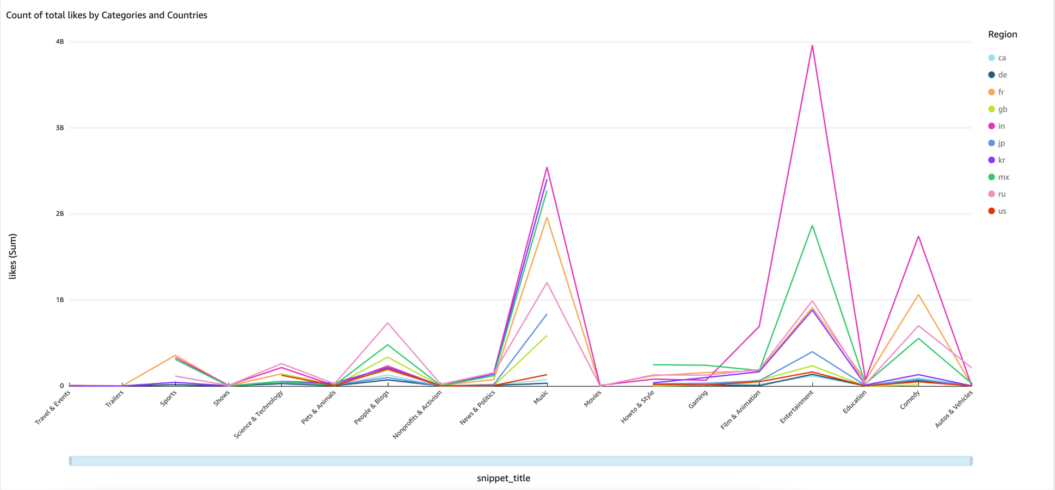
8. Count of total likes by categories and countries:

